Slide 1
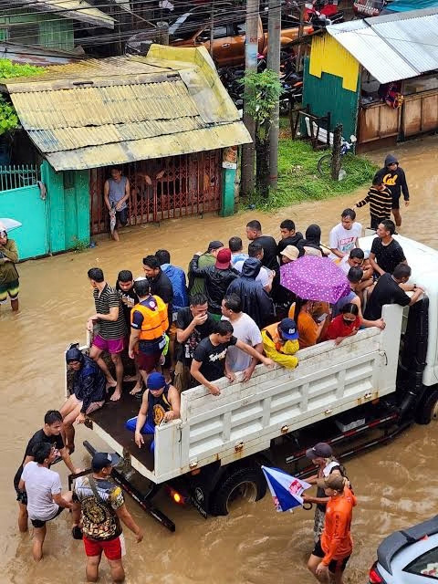
Integrated Disaster Incident Record Management and Automated Situation Report Generation System
Perez, Katrina Mae D.G.
Somosa, RJ P.
September 29, 2026
Notes:
INTRODUCTION:
- An image tells a lot of stories. In this image, it is certain that crisis has arise. But do we know its severity? are we really truly aware of what is happening? do we know how many people are effected? the families, the individuals, the vulnerable. whether the reports are progressive. and what truly is being gather in times of disaster. Our project focuses on that path: from Purok reporting, through Barangay verification and consolidation, to DRRM report preparation.
- Introduce names and then the project

Slide 2
Presentation Flow
1
Motivation
2
Status Quo: How and Why
3
The possibility: How and Why
4
Methodology
Notes:
- for this brief, we are going to discuss the motivation of the study. why we are putting our hearts in this study.
- thereafter, we will discuss the status quo. how it is in the present, why, and why not stay this way
- we will then present the possibility, our proposal, that enables a better proactive workflow
- finally, we would present the inner workings of our proposal

Slide 3
Motivations
  Sendai Framework (2015-2030) is the Global agreement adopted by UN member states to reduce disaster impacts through proactive risk management, not just emergency response.
  Republic Act No. 10121, also known as the Philippine Disaster Risk Reduction and Management Act of 2010, is the core legal framework governing disaster management in the Philippines
  Operation L!STO is DILG and Local Government Academy initiative that strengthens local disaster preparedness through manuals and capacity development
  The importance of data: for assistance and aid, for risk analysis, for planning, and for auditing
Notes:
- lets first look in the motivations of our proposal.
- These three frameworks, Sendai Framework (international anchor), Republic Act No. 10121 (for the National level), and Operation L!STO (as for the local level) highly encourages a proactive approach to disaster risk reduction and management
- Prior to these frameworks, we have been adapting a reactive approach to DRRM
- in this proactive approach, disaster information and data is incredibly crucial as it is. It is utilized in all of the three phases of disaster (namely disaster prepareation, response, and recovery)
- it is used for risk analysis and planning, for emergency response, and for auditing, logging, and post-disaster needs

Slide 4

Status Quo

Slide 5
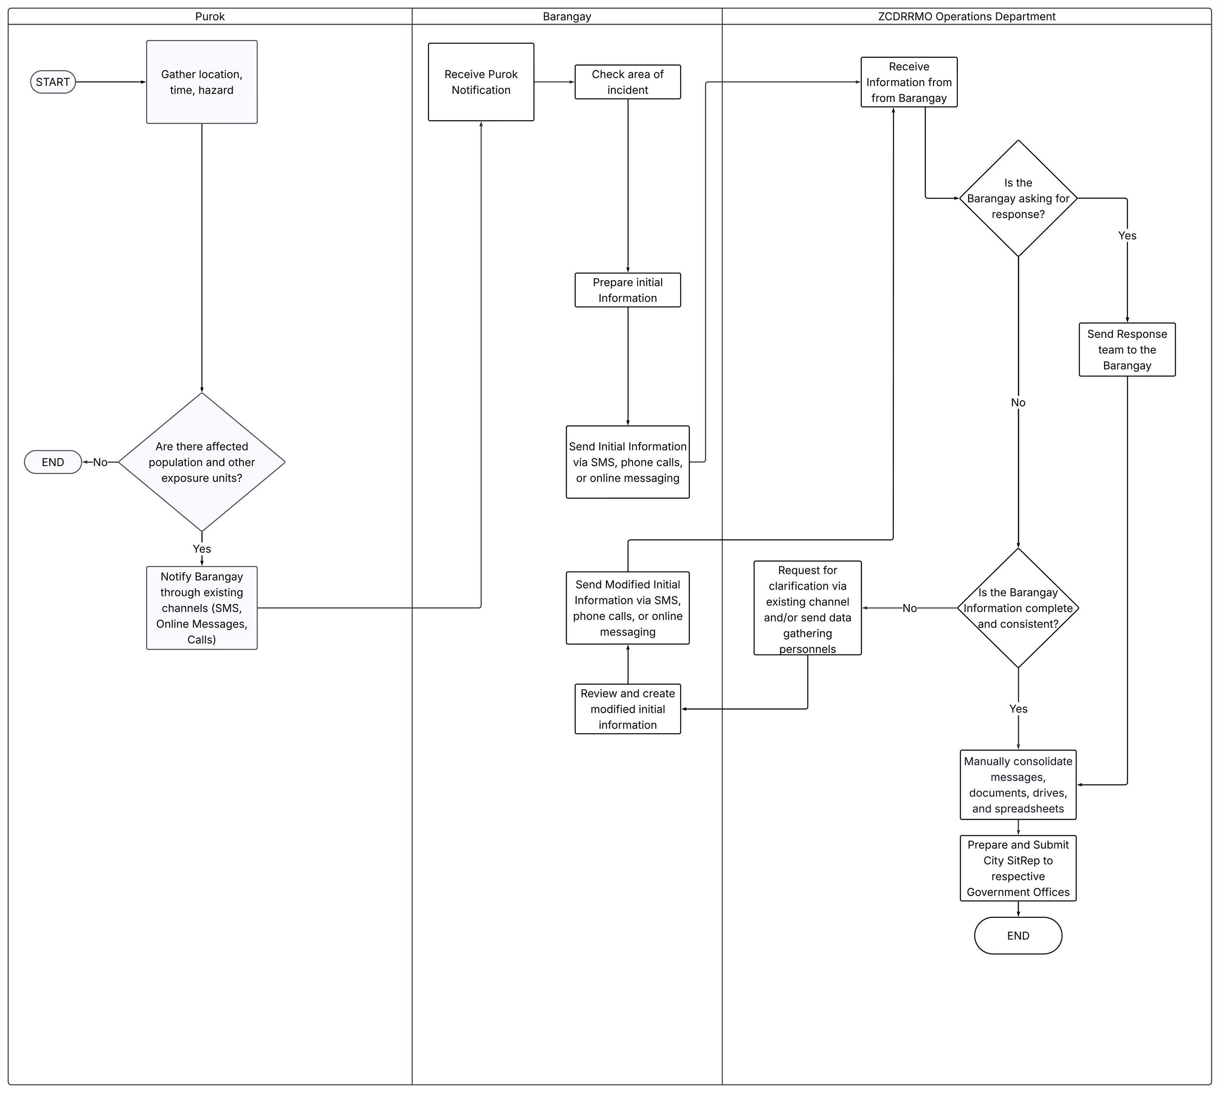
Current Workflow

Slide 6
Problem Statement
  Communication Delay
  Limited data sharing
  Time-consuming record management
  Inefficient verification

Slide 7

The Possibility

Slide 8
Proposed System Objectives
General Objective
Specific Objective
Design, develop, and evaluate a centralized, role-based online system for grassroots incident reporting and NDRRMC SitRep Consolidation for Local Government Units (LGUs)
Build the following:
  User Management Modules
  Profile Management Modules
  Hazard Module
  Incident Reporting Modules
  Situation Report Modules
  Dashboards
Notes:
- the general objective of the system is (...)
- in practice, the system is intended to provide a shared reporting process while keeping access and responsibilities appropriate to each level
- The specific objective translates this aim into 17 modules on around 6 areas
- User management modules handle account creation and verification for Purok, Barangay, and DRRM personnel, with account creation assigned to authorized higher-level users.
- Profile Management Modules will record and verify aggregate community information, with Barangay Profiles built from verified Purok Profile. This could eventually lead to the DRRM Profile if possible
- The Hazard module will maintain hazard information using classification aligned with CDRA (or the organization's CDRA)
- Incident Reporting will support an initial purok report followed by Barangay review, verification, and the consolidation. The same would then happen from Barangay to DRRM
- Situation Report modules help DRRM Administrators prepare, edit, and retrieve reports based on verified submissions.
- Finally, dashboards will show role-appropriate summaries and report statuses.
- For all of the reports, versions are embedded and is necessary
- Together, these objectives define what the system will build and evaluate whether its modules support the intended reporting process.

Slide 9
Problems, Objectives, Methods
Problems | Objectives | Methods
Communication Delay | Streamline submission and status tracking | Role-based online submission routed upward from Purok through Barangay to DRRM
Manual Record Management | Reduce repeated handling and support report preparation | Centralized records with report history and editable SitRep drafts
Limited Data Sharing | Provide authorized access to information needed for consolidation | Role-and jurisdiction access to source-attributed records and dashboard
Inefficient Verification | Improve completeness and traceability of review | Staged human review supported by completeness and consistency checks, recorded decisions, and correction reasons
Notes:
- This matrix traces each identified problem to an objective and a proposed method.
- For communication delay, the objective is to streamline submissions and status tracking. The method routes role-based reports from Purok through Barangay to DRRM.
- For manual record management, the objective is to reduce repeated handling and support report preparation. Centralized records, report history, and editable Situation Report drafts support that work.
- For limited data sharing, the objective is to give authorized users access to information needed for consolidation. The method uses role- and jurisdiction-based access while preserving the source of records.
- For inefficient verification, the objective is to improve completeness and traceability. The system supports staged human review with completeness and consistency checks, recorded decisions, and correction reasons. These checks can flag gaps or inconsistencies, but the reviewer remains responsible for judging the information.

Slide 10
Proposed System
what
why
how
A centralized web system for aggregate profiles, incident reports, verification, report history, and editable SitRep drafts
The paper identifies delays, manual record handling, limited data sharing, and inefficient verification in the current workflow
Purok submits initial information, Barangay verifies and consolidates it. DRRM reviews verified reports and prepares the SitRep draft

Slide 11
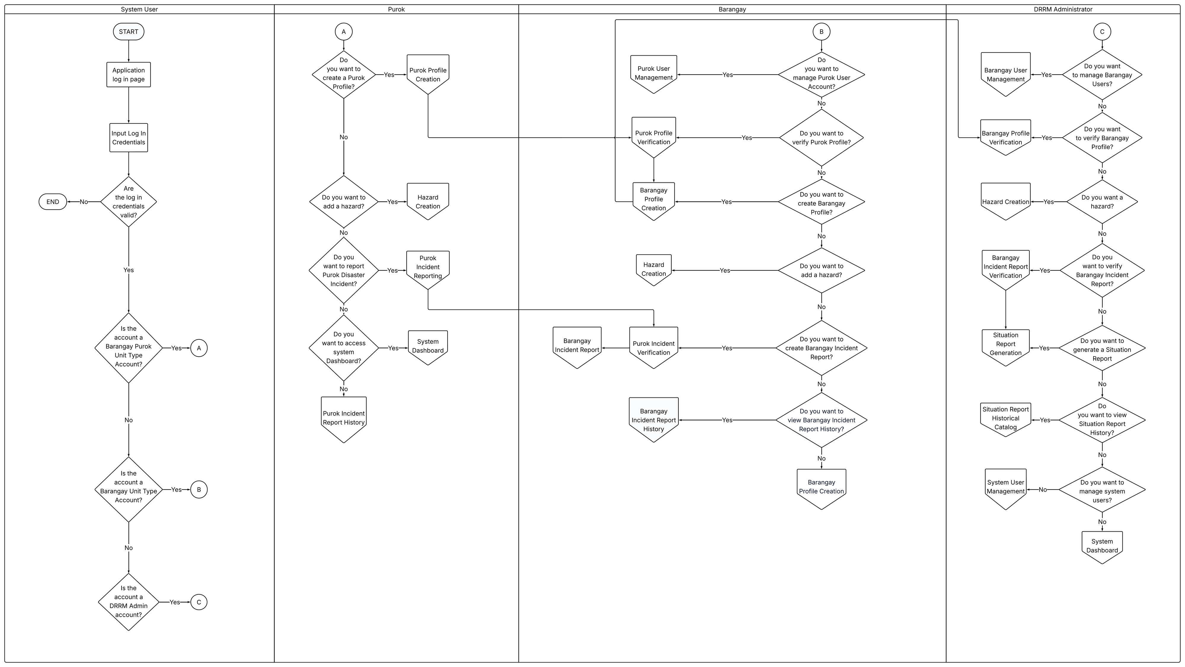
Notes:
- the flowchart is divided into four swimlanes: System User, Purok, Barangay, and DRRM Administrator
- the first lane just simply shows the login and directs each valid account to the appropriate user flow
- the main information moves upward through two paths
- for profiles, Purok user submits its aggregate profile to the Barangay user for verification. Barangay personnel use verified Purok information to create the Barangay profile, which the goes to the DRRM for verification
- for incident reporting, Purok usersubmits an initial incident report to the Barangay. After review, Barangay user will then use the consolidated verified data to prepare the Barangay Incident Report. Verified Barangay Incident Reports provide input for Situation Report Generation
- The diagram also includes account management, hazard creation, report history, and dashboards as supporting processes. Its central flow is the review and consolidation of Purok information as it moves through the Barangay to DRRM.

Slide 12
Scope and Limitation
Scope
Limitation
  Centralized, web-based platform for disaster incident recording and automated SitRep generation
  Configurable for any participating DRRM organization, with ZCDRRMO as pilot
  Three-level structure: Purok (initial reporting) → Barangay (consolidation & verification) → DRRM Administrator (hazard classification, SitRep generation, system oversight)
  Hazard coverage follows each organization's own CDRA, not a fixed list
  Covers during- and post-disaster phases only, excludes pre-disaster preparedness and risk-monitoring under RA 10121
  Excludes Situation Reports for non-disaster events
  Web-based only, no offline mode or SMS fallback; requires stable internet
  Built for internal DRRM use, does not handle public announcements

Slide 13

Features | Bandilyo App | AGAPP | iRespondPH | Mamamayan | SitRepO
User Management
Real-time Reporting
Geolocation, Geotagging
Community/Jurisdiction Hazard-Exposure Profiling
Initial Disaster Reporting
Report Verification
Hazard/Disaster Event Creation
Disaster Situation Reporting
Update Situation Report
Situational Report (SitRep) Generation
Situation Report Historical Catalog
System Dashboard
Search, Filter, and Export
Related Systems

Slide 14
Methodology

Slide 15
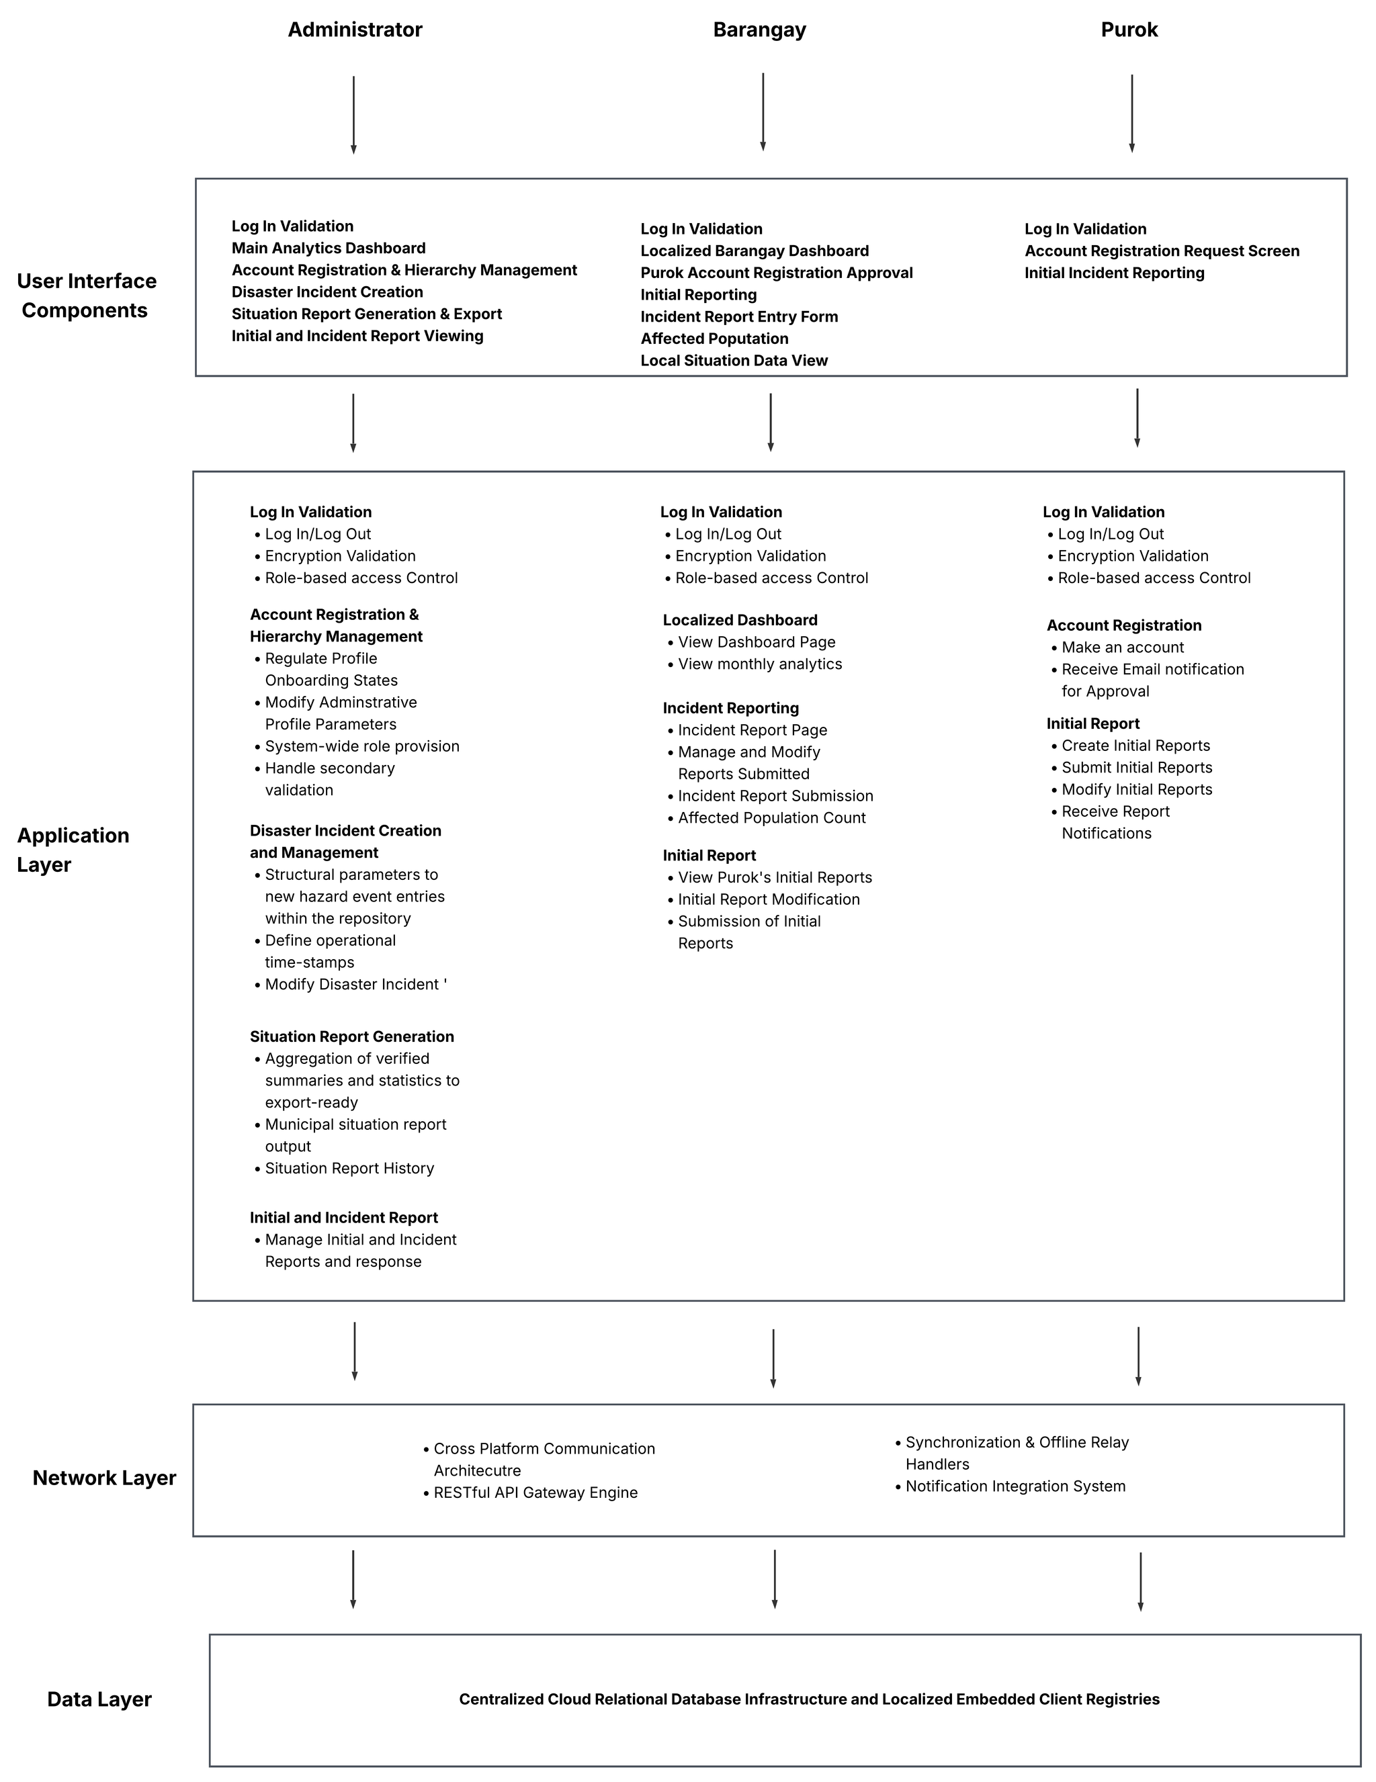
Architectural Design

Slide 16
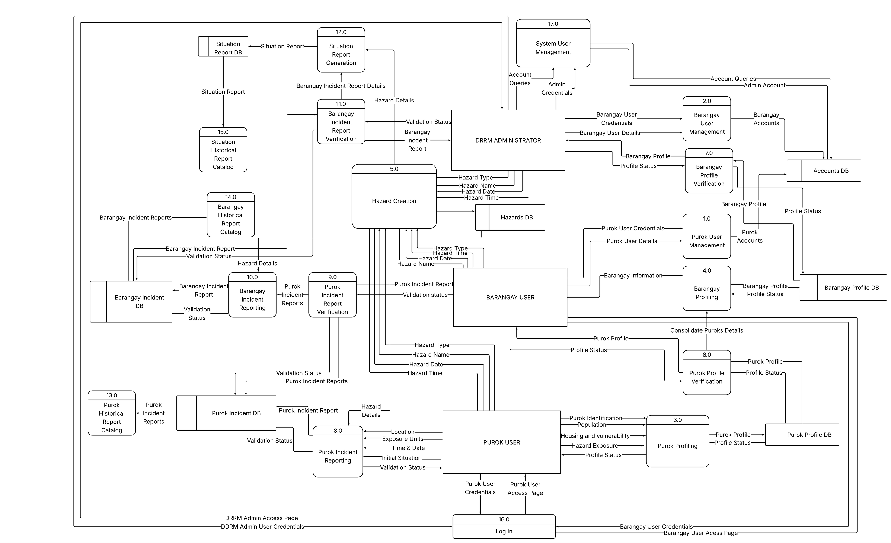
Notes:
- this level 0 DFD presents how data moves among the three users: Purok User, Barangay User, and the DRRM Administrator.
- the numbered processes show what the system does with the data
- for profiling, Purok user submits identification and aggregate population, housing, vulnerability, and hazard-exposure information. The Barangay verifies Purok profiles and consolidates verified details into the creation of the Barangay profile, which the DRRM Administrator then reviews
- for incident reporting, Purok users submit initial hazard details, location, time, situation, and exposrue information. The Barangay reviews these Purok reports, consolidates them into Barangay Incident report, and sends that report to the DRRM Administrator for verification. Verified Barangay Incident details then support Situation Report Generation and are retained for later retrieva. Validation statuses also return through the reporting process
- Account management, hazard creation, dashboards, and report catalogs support these main flows. The DFD focuses on data movement and processing, rather than the screen-by-screen user decisions.

Slide 17
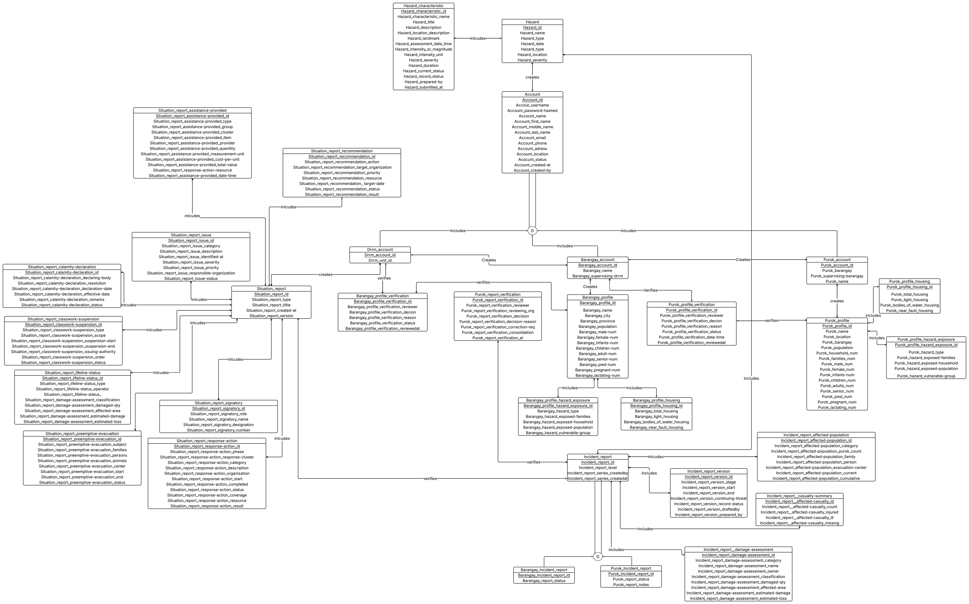
Notes:
- This Entity Relationship Diagram presents the proposed system’s main data entities and their relationships. It can be read in four groups.
- First, the Account entity represents shared account information, with separate DRRM, Barangay, and Purok account subtypes. The Hazard entities hold hazard records and their characteristics.
- Second, the profile entities represent Purok and Barangay information. Related housing and hazard-exposure entities hold supporting profile details. Separate verification entities record the reviewer, decision, reason, status, and review date. The Barangay profile is connected to the Purok information it consolidates.
-Third, Incident Report is the central record for incident information. Purok and Barangay report entities distinguish the reporting level. Related entities preserve report versions and organize affected-population, casualty, and damage-assessment information.
- Finally, Situation Report connects to entities for report content, including response actions, issues, recommendations, assistance, evacuation, lifeline status, declarations, and signatories. This structure separates the report document from its detailed sections.

Slide 18
Testing
1
Alpha Testing
  Unit and component checks: Jest
  Backend API checks: Jest and Supertest
  End-to-end responsive checks: Cypress
  System integration and security testing
2
Beta Testing
  User acceptance with intended roles
  10-item System Usability Scale
  Proposed mean score target: 68 or higher
  Proposed exit: zero unhandled crashes or render failures on tested views

Slide 19
t
What’s next?

Slide 20
Thank You

